Slide 1
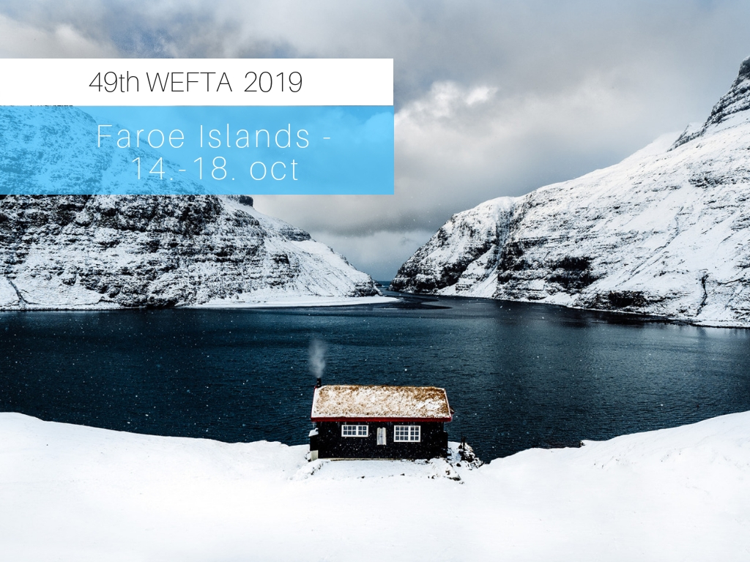

Slide 2
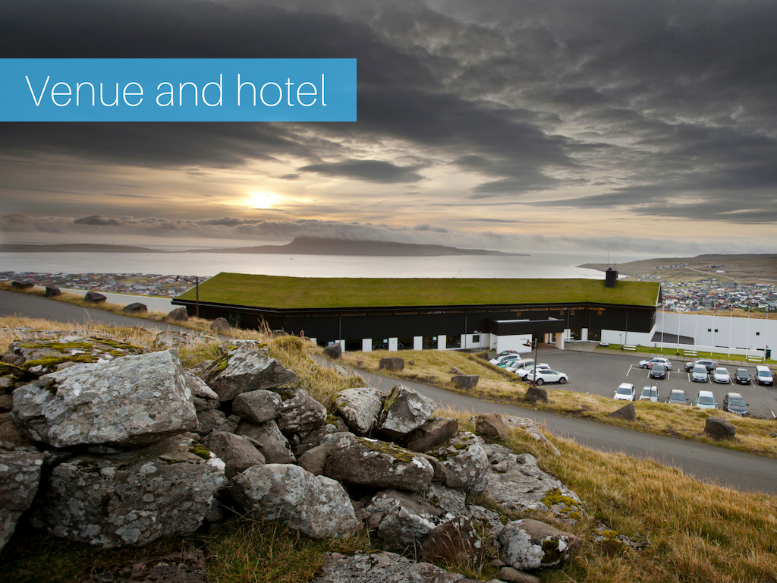

Slide 4
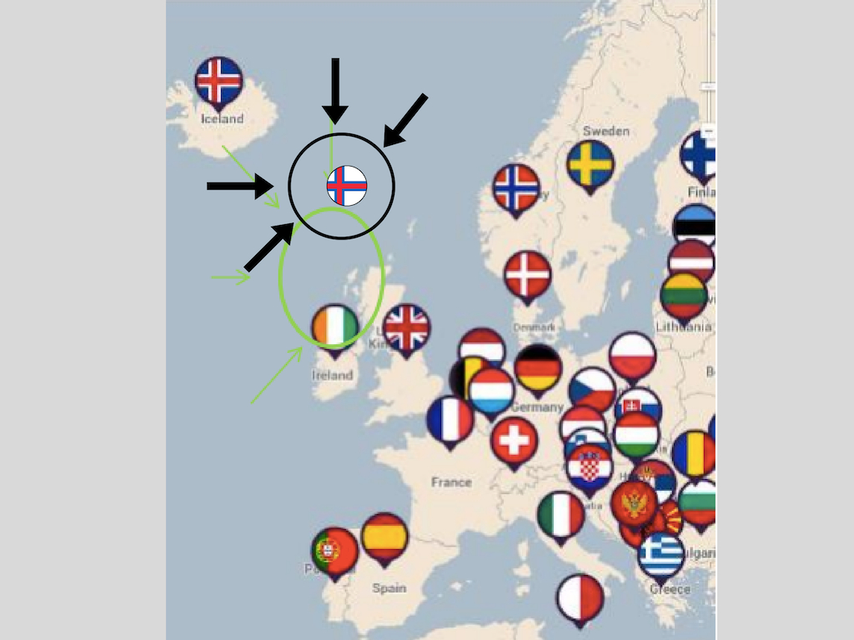

Slide 8
The link to the autumn film – Visit Faroe Islands
https://vimeo.com/106994501

Slide 9
